Slide 1



Threat Modelling First Aid
Threat Modelling for Total Beginners
Petra Vukmirovic - Glasswall InfoSec Team
Dinis Cruz - Glasswall CISO

Slide 2
Threat model
Process to identify vulnerabilities on an application and mitigate them ​
If the vulnerabilities, Threats, Risks and Controls are identified you already have a threat model!​
STRIDE
ATTACK TREES
Pentest on paper

Slide 3

Threat Model
Vulnerability
A flaw in architecture – a weakness that can be exploited​
It can be a security bug in code, a flaw in the operating system, in processes, hardware, in a database, browser, or within people
Threat
Any vector or agent that has the potential to take advantage of a vulnerability

Slide 4
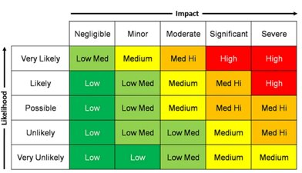
RISK
Threat + Vulnerability = Risk
Determine Risk Likelihood and Impact to calculate Risk Level

Slide 5
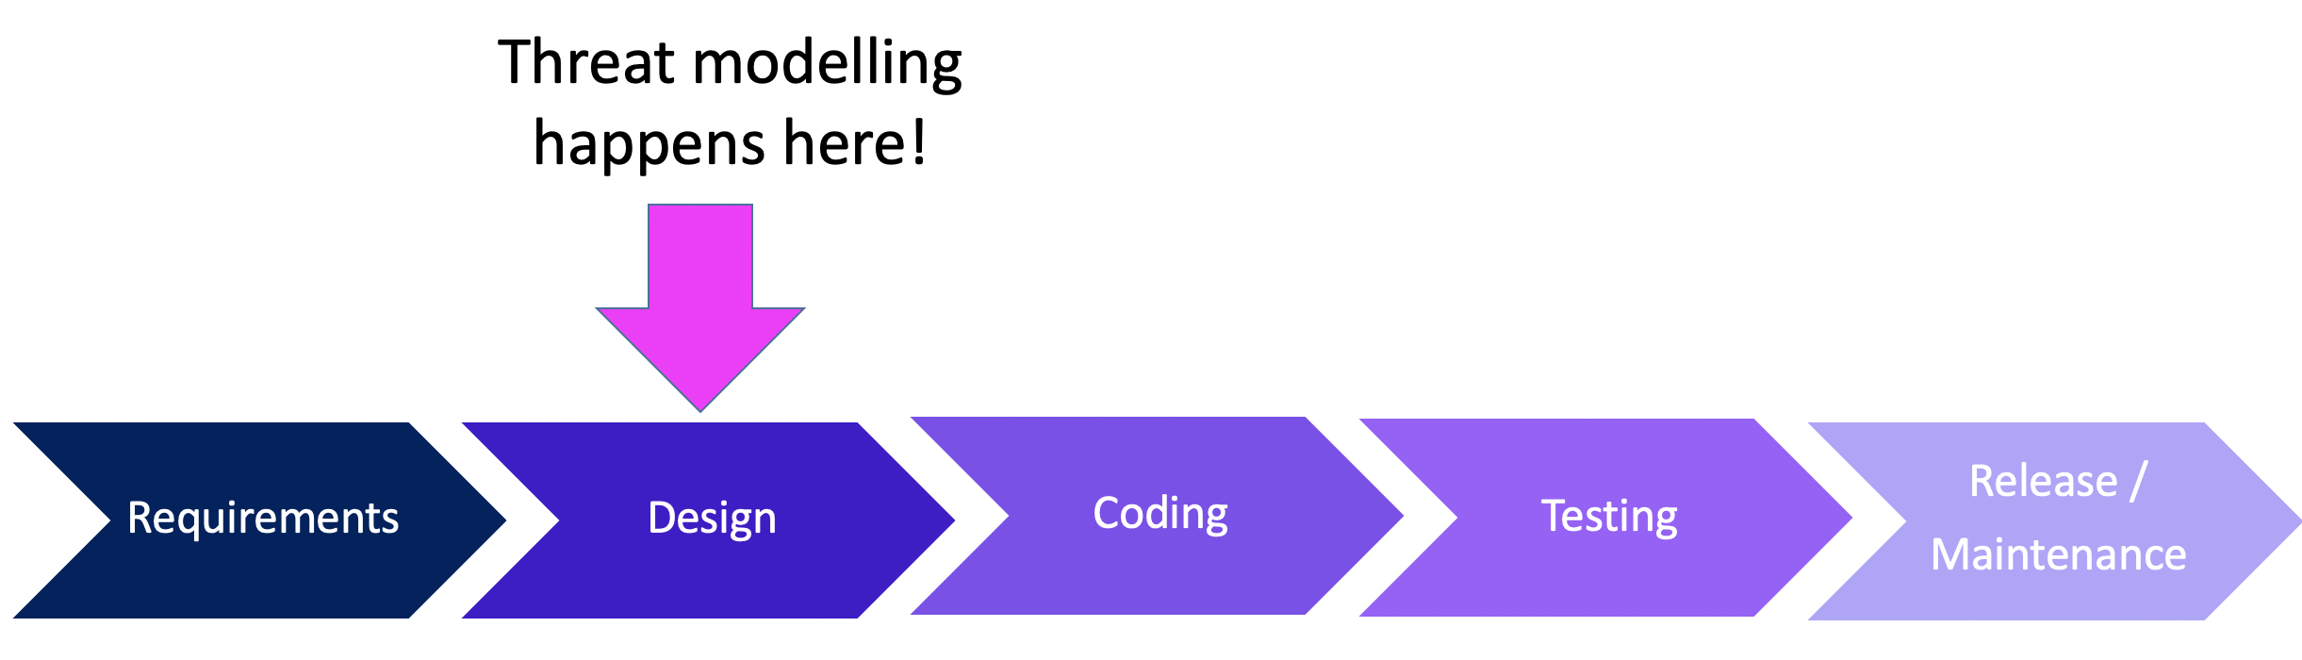
Threat Model
At the moment of launch every safe application should have a valid threat model already
Developers should initiate threat model creation to delegate the risk to higher management which can then either accept the risk or ask for risk reduction controls to be implemented (tangible and intangible risks)
In Glasswall Threat Modelling is initiated by the Development Team on Jira https://glasswall.atlassian.net/browse/PLAYBOOK-23
InfoSec assistance can be sought on every step of the process

Slide 6
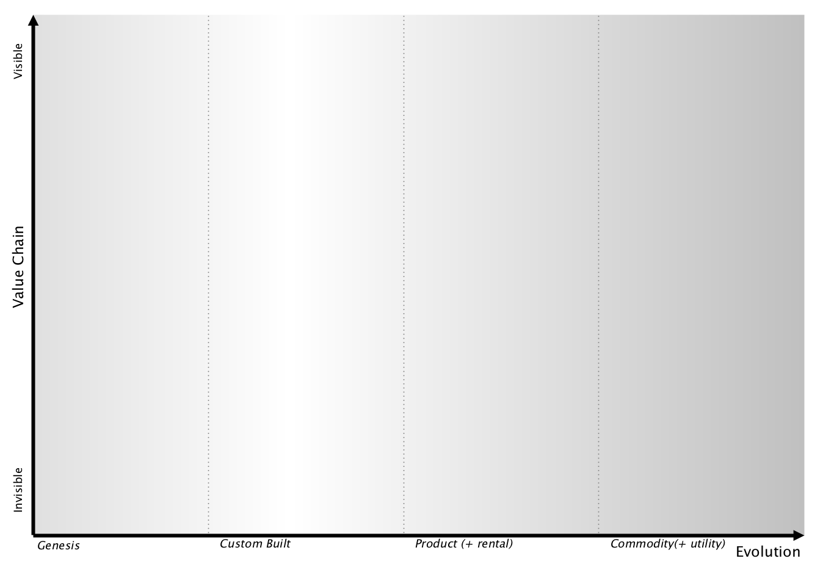

Application
Threat Model
Risk Assessment
Threat Model Completed
Information Security Team
Security Champion: Threat Modelling Formation
Threat Modelling Playbook Jira (OWASP)
Developer: Threat Modelling Genesis

Slide 7

 | Meaning | Description | Attacks
S | Spoofing | Impersonating another person/process | Cookie Replay, Session Hijacking, CSRF
T | Tampering | Unauthorised Alterations | XSS, SQLi
R | Repudiation | Denying Claims/Unproven actions | Audit Log Deletion, Insecure Backup
I | Information Disclosure | Exposure to unauthorised person/process | Eavesdropping, Path Traversal
D | Denial of Service | Service unavailability | Website defacement
E | Elevation of Privileges | Increasing person/process access level | Logic Flow Attacks, Buffer Overflow
Notes:
Some Windows services are configured to run under the Local System user account. A vulnerability such as a buffer overflow may be used to execute arbitrary code with privilege elevated to Local System.

Slide 8
Step 1: Profile the Application (Developer Role - Genesis):
Deployment Environment
Users
What are the Data Elements
What permissions will the actors have?
What technologies will be used? OS, Web/App Servers, Databases, Architectures, Programming Language
What security mechanisms apply? (CIA) – InfoSec team cooperation
Threat Model In Practice (OWASP MODEL)
Confidentiality
Availability
Integrity

Slide 9
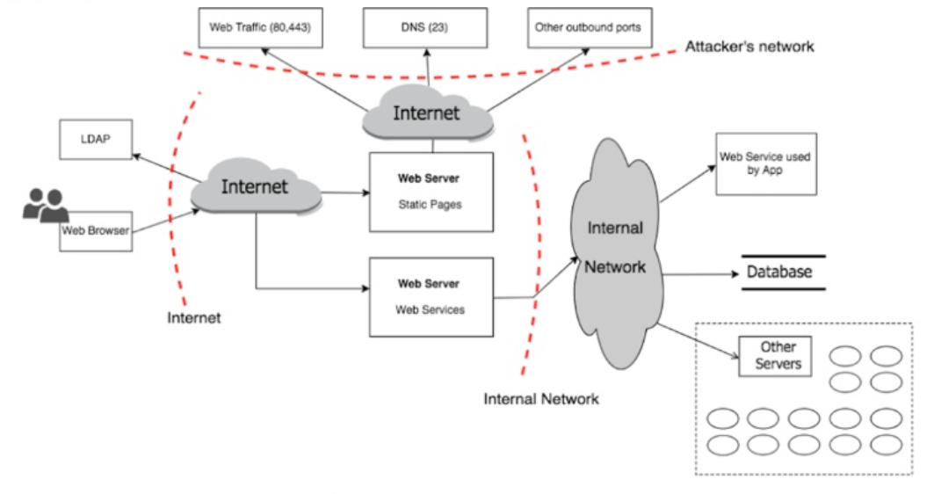
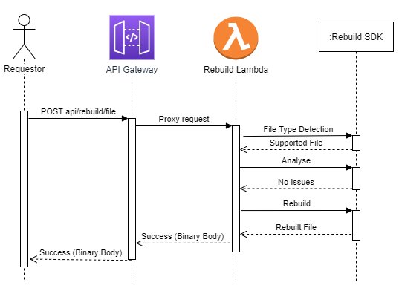
Step 2: Decompose Your Application (Developer Role - Genesis):
Trust Boundaries (indicates where trust level changes)
Firewall
Webserver -> Database
Your App -> External 3rd party Services
Entry Points (Principal attack Targets)
Ports, Pages, Components, APIs, Stored Procedures
Exit Points
Pages that display data, functions sending out values
Data Flows
Should we validate data at each node?
Threat Model In Practice (OWASP MODEL)
Notes:
Dinis to talk about this?

Slide 10
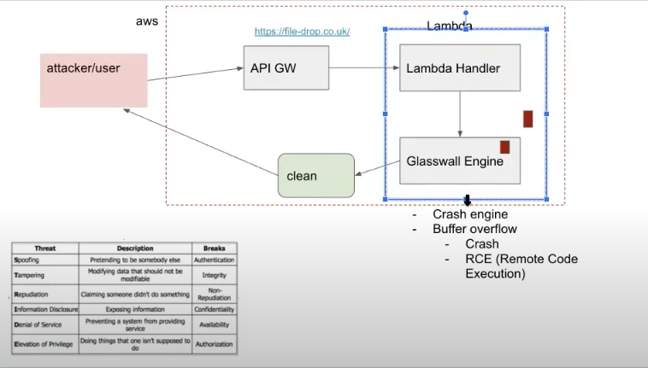
Threat Model In Practice
Notes:
Dinis to talk about this

Slide 11
Identify threats that apply only to the application Context & scenarios generated in the previous step
Use Attack Trees
Think like an Attacker (STRIDE/DREAD)
Create the threat list: SQL Injection, XSS, Replay Attacks, MITM, Eavesdropping
Step 3 Identifying Threats (InfoSec and Dev)

Slide 12
Step 4: Identifying Vulnerabilities (Infosec and Dev):
Identify vulnerabilities that apply only to the threats generated in the previous step
Vulnerabilities identified should be factored to shape the design of the application
Generate security test cases for testing in development stage (Typical vulnerabilities may be):
Weak Encryption
Clear Text Credentials
Unhandled Exception
Dynamic SQL
Long Session Timeouts
Threat Model In Practice (OWASP MODEL)

Slide 13
Threat Model In Practice
Step 5: Rank The Threats (Infosec and Dev):
Ranking provides the necessary insight to the risk of the threat
Risk can be
Accepted
Mitigated
Transferred
Ignored (Avoid this)
Two methods for ranking
Probability * Impact Ranking
DREAD Average Ranking

Slide 14
In other words ask yourself some questions:
Is the Application Vulnerable to OWASP Top 10 Web Application Threats?
https://owasp.org/www-project-top-ten/​
​How safe is the API to intrusion? What protocols are used?
Are there any exposed API keys in the code or anywhere else?
Is the data encrypted at rest and transit?
What can an attacker do to get access to you Web Application and once access obtained, what further damage can be done to the application / customer data?

Slide 15
Online Threat Modelling Tools
https://online.visual-paradigm.com/drive/#diagramlist:proj=0&new=ThreatModelDiagram
https://owasp.org/www-project-threat-dragon/
https://github.com/filetrust/threat-model-cookbook
https://www.owasp.org/index.php/OWASP_Threat_Model_Cookbook

Slide 16
LETS DO A THREAT MODEL NOW!

Slide 17
Scenarios:
Threat Modelling Password Complexity With 2 FA
Using Lambda/Azure Functions to process malicious files
API Keys in Public GitHub Repos during an incident
Power Bi Scenario
Do you have any questions for developers or business owners? Ask in breakout rooms!

Slide 18
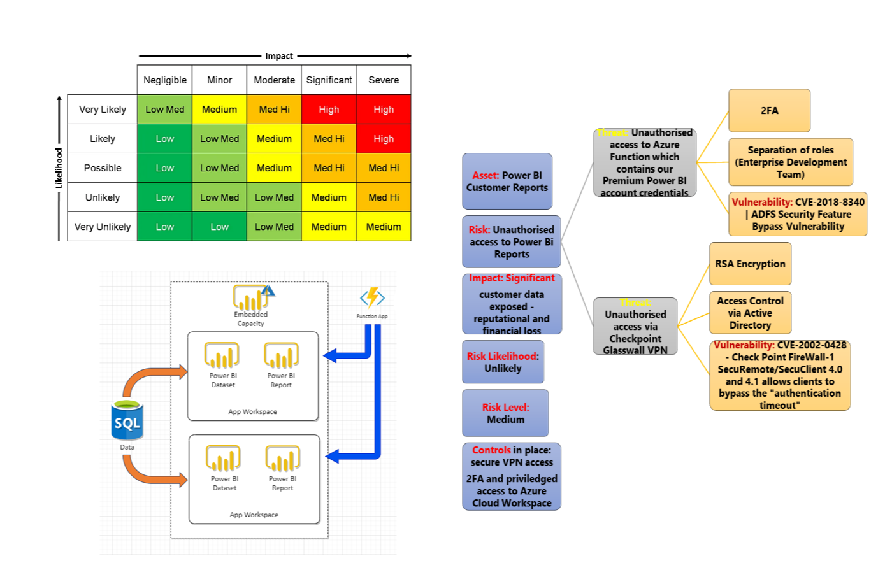
POWER BI THREAT MODEL SCENARIO
Lets complete this threat model by asking the developers more questions ☺
Ask away!

Slide 19

What is Next?
​More About Threat Modelling
Check out more about OWAS TOP – this is your secure coding bread and butter! ​
Checkout the secure coding practice guideline & the SANS secure coding checklist
Keep an eye on the most common vulnerabilities​

Slide 20
References
D. Cruz, Using Threat Models To Control Project Brief 2017. Accessed at https://www.slideshare.net/DinisCruz/using-threat-models-to-control-project-brief​
OWASP, Advanced Threat Modelling. D. Cruz, Using Threat Models To Control Project Brief 2017. Accessed at https://www.slideshare.net/DinisCruz/using-threat-models-to-control-project-brief​
Microsoft, Security Development Lifecycle 2010. Accessed at https://www.microsoft.com/en-us/download/confirmation.aspx?id=12379​
OWASP, Top 10 Web Application Security Risks 2017. Accessed at https://owasp.org/www-project-top-ten/
Microsoft, Security Development Lifecycle 2010. Accessed at https://www.microsoft.com/en-us/download/confirmation.aspx?id=12379​

Slide 21
Thank You for Your Attention
Questions?

